Slide 1
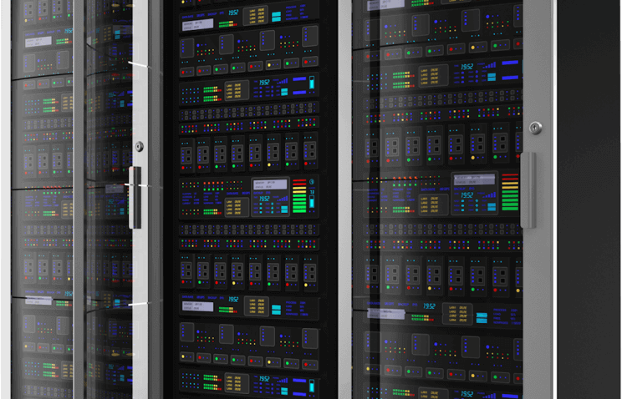

Slide 2

Big Data Analytics
Ali Al Badra
Mashal Al-Busaidi
Khalid Alharthi

Slide 3
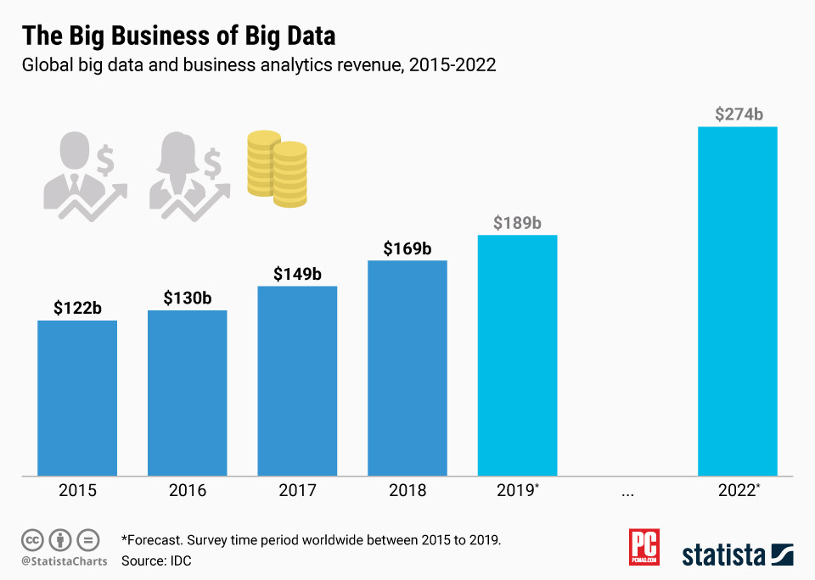
Market

Slide 4




Targeted customer

Slide 5
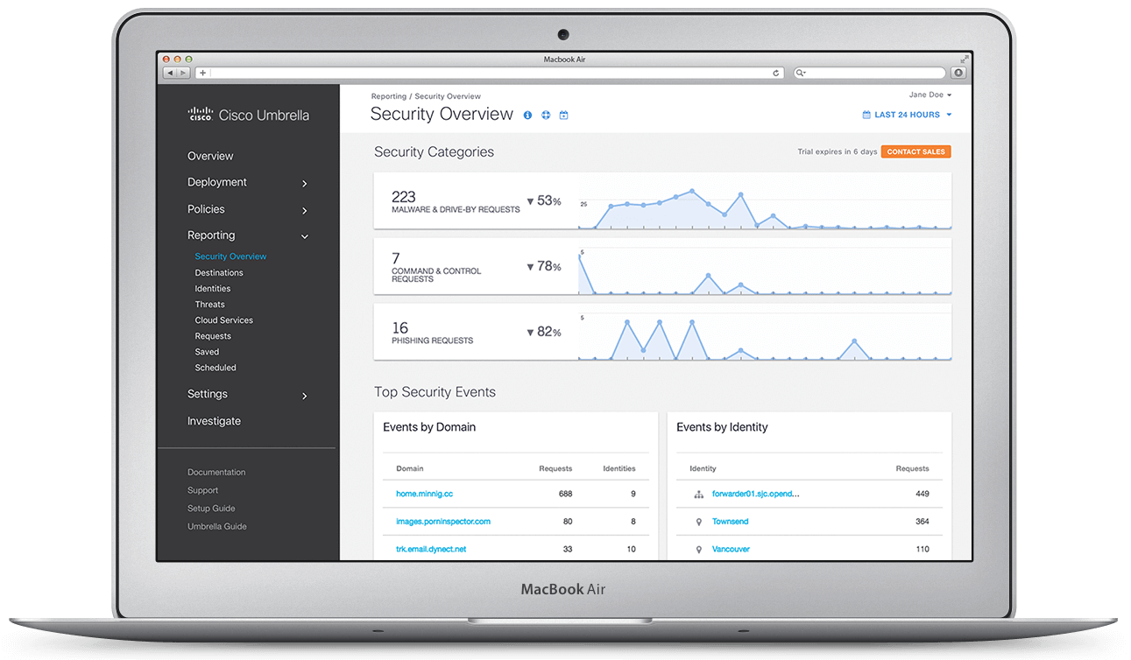
Cisco
DNS BIG DATA ANALYTICS

Slide 6
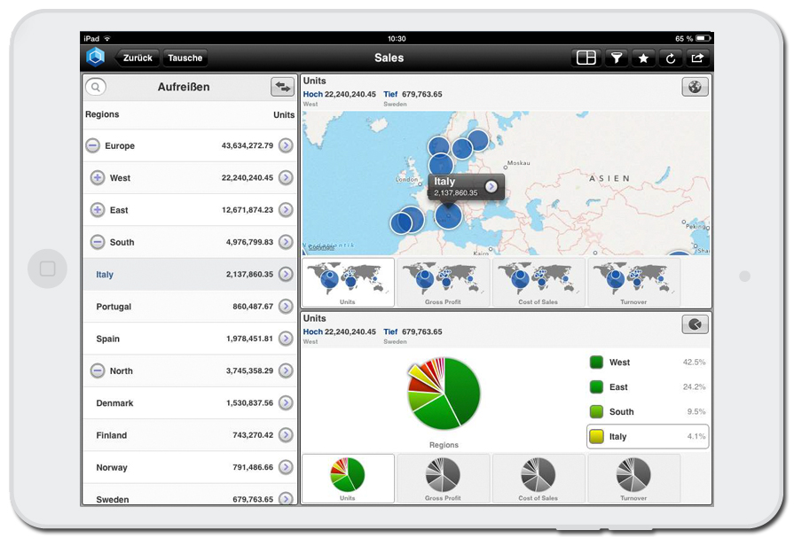
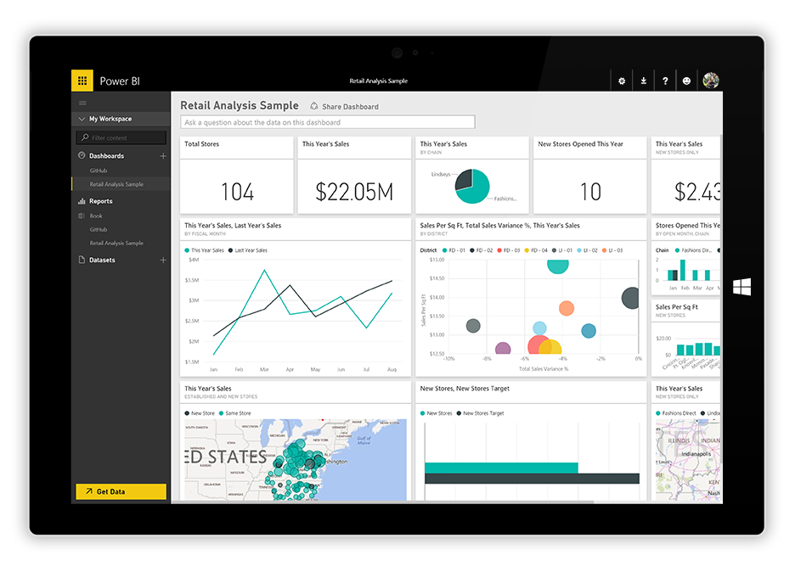
Business Intelligence
Companies
Schools
Universities

Slide 7
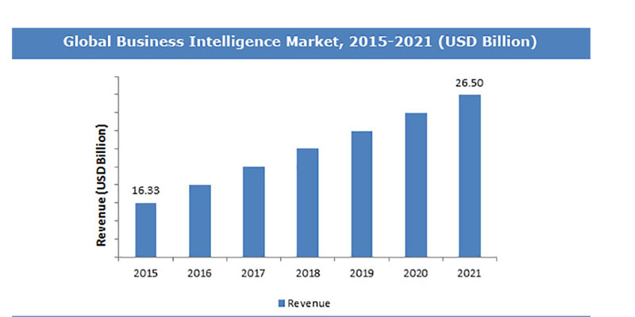
Business Intelligence
DATA ANALYTICS

Slide 8
Business Intelligence Tools
Microsoft Power BI
JasperReports Server
Jedox
Helical Insight
The ELK Stack

Slide 9

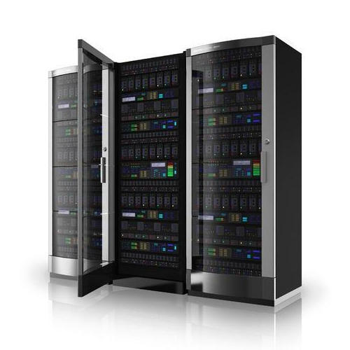
Technical Specifications

Slide 10
Entrada
Hadoop and impala
AWS and Athena
Local

Slide 11
Requirements of Entrada
Docker
Entrada
Graphite
Grafana
Database
PostgreSQL
Impala
Hadoop
HDFS

Slide 12

Grafana

Slide 13



Slide 14
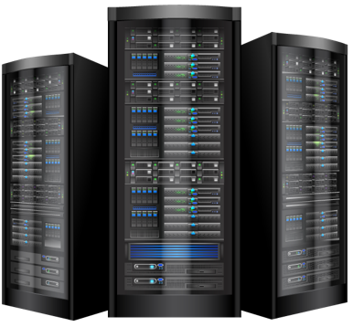
Cost Assumption
Tool | Number | Cost - OMR
Desktop Computers | 3 | 500
Workspace Rent | 1 | 350/month
Employee Salary | 3 | 800/month
Software Licensing | - | Free
TOTAL FIXED | - | 1,500
Annual Running Cost | - | 33,000
TOTAL + RUNNING COSTS (~ 1 Y) | - | 34,500

Slide 15

Services Provided
Service | Pricing (OMR)
BI Software License | 2,000
Entrada Annual Contract | 20,000
BI Annual Contract | 8,000
Plugins | 1,000– 5,000

